Slide 1
Evaluating Financial Crises and Stock Market Trends Using
Technical, Market, and Fundamental Indicators
Data Visualization Group Project
Management of Financial Institutions
MGT-6090
Group Members:
Rebecca Zhang
Jason Zhongyun Zhang
Hao Zhang

Slide 2
Literature Review
Market Indicators
Technical Indicators
Fundamental Economic Indicators

Slide 3

Dependent Variables
Farma-French’s 2*3 portfolios based on Size and Book-to-Market
SMALL LoBM
ME1 BM2
SMALL HiBM
BIG LoBM
ME2 BM2
Farma-French’s 5 portfolios based on sectors
Consumer
Manufacturing
High technology
Health care
Others
Overall Market: SPY index

Slide 4
Three Types of Indicators
Market Indicators:
CBOE VIX
CBOE Equity Put-Call Ratios
Technical indicators (all based on the overall market index SPY):
MA (5, 10, 50, 100, 200 days from SPY)
Relative Strength Index (below 30 is oversold, above 70 is overbought)
Bollinger Band (lower band, 20 day MA, upper band)
Fundamental indicators
Unemployment rate
CPI growth rate
PPI growth rate
San Francisco Tech growth rate

Slide 5
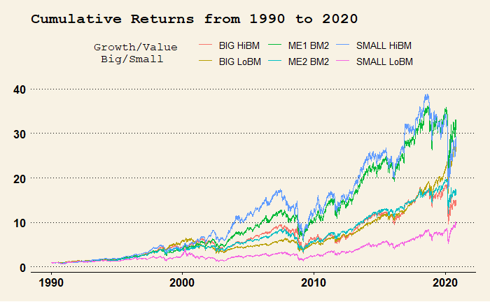
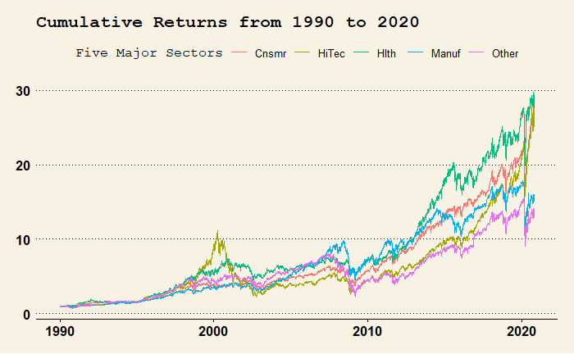
Preliminary Findings: General Trend from 1990 to 2020
Key Observations:
Small value stocks tend to do very well in the long run
Growth stocks tend to generate less returns than value stocks
Small growth stocks do not do very well
The healthcare sector generated most returns
The consumer sector experienced less maximum downfalls and volatilities
The manufacturing sector did not generate much profits in more recent years

Slide 6
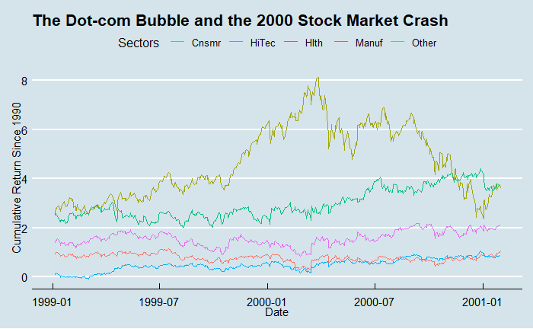
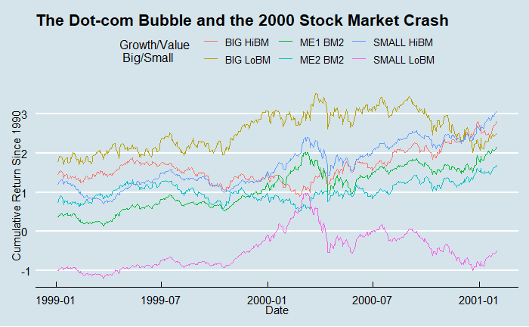
Visualizing the Dot-com Bubble and the Market Crash of 2000-2001
Key Observations:
The high technology sector experienced the most increase before the bubble popped
Other sectors did not experience too much downfall during this market crash
But even if the technology sector had decreased, their values are still quite close to when the bubble started
Small-cap growth stocks experienced the most volatilities during the same time
They were not able to jump back very soon as compared with other stocks
Big-cap growth stock instead seem to do quite well in the meanwhile
Both big-cap and small-cap values stocks performed better than others during the crisis

Slide 7
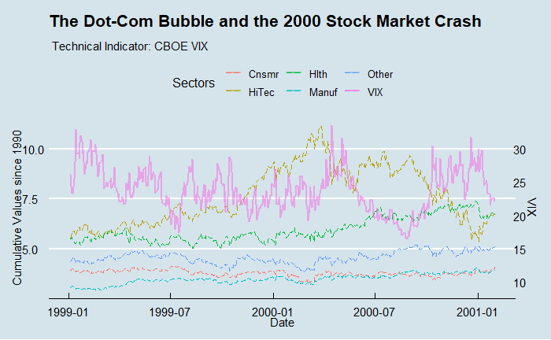
Visualizing the Dot-com Bubble and the Market Crash of 2000-2001
Key Findings:
Highest volatilities one year before the market crashed
Lowest volatilities soon before the market reached the peak and crashed later
Relatively higher volatilities when the market reached its bottom

Slide 8
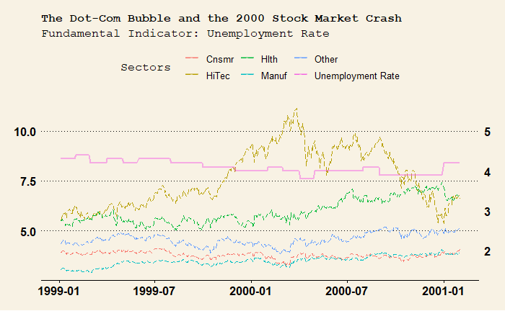
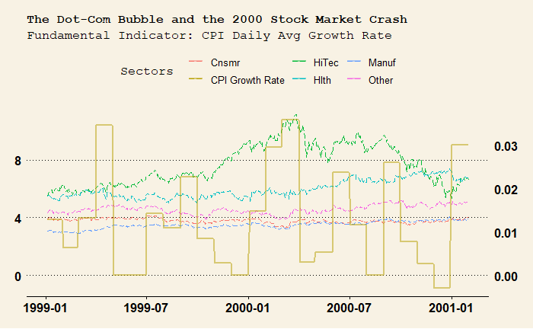
Visualizing the Dot-com Bubble and the Market Crash of 2000-2001
Key findings:
Unemployment rate did not experience too much oscillation during the Dot-com Bubble market crash
CPI growth rates experienced normal seasonal changes

Slide 9
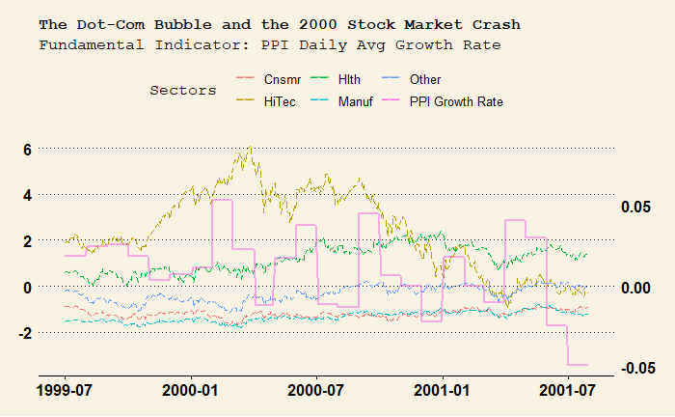
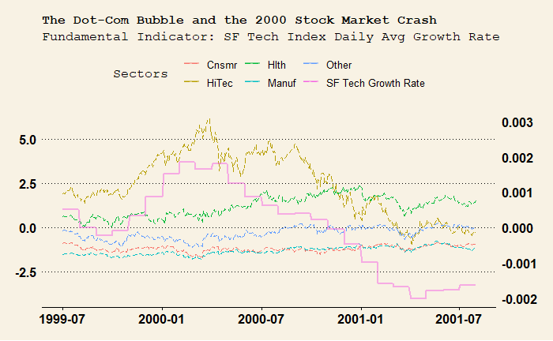
Visualizing the Dot-com Bubble and the Market Crash of 2000-2001
Key findings:
PPI growth rates slightly decreased during the same period
The San Francisco Tech Index growth rates are quite synchronized with the high technology sector of the market

Slide 10
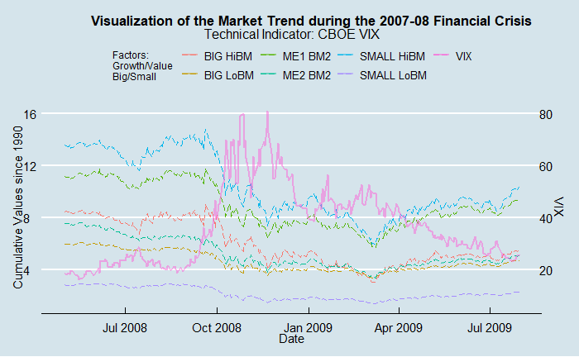
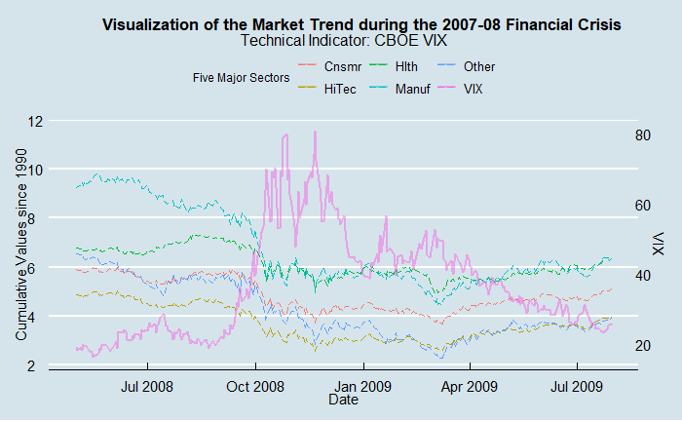
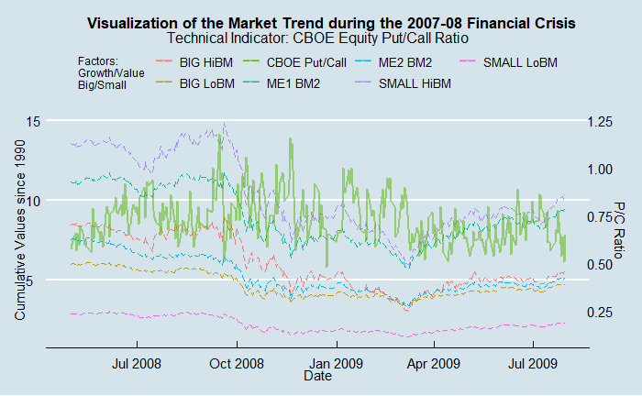
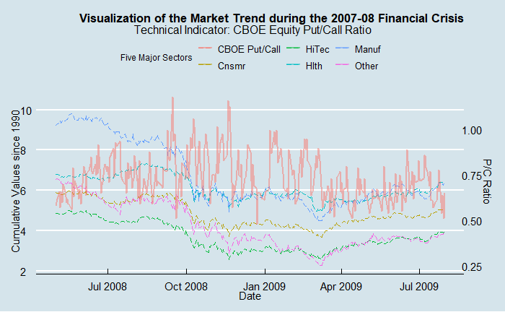
Visualizing the Market Trend During the 2007-08 Financial Crisis
Key Findings:
The manufacturing sector still experiencing another peak until the mid-2008 while other sectors started going down after reaching the peak since October 2007
The volatility index remained low soon before the market started to plunge
The volatility index reached two peaks, after the second of which the market started recovering
Put/call ratios experienced more ups and downs than VIX during the same time
Higher put-call ratio when the market did not reach the bottom

Slide 11
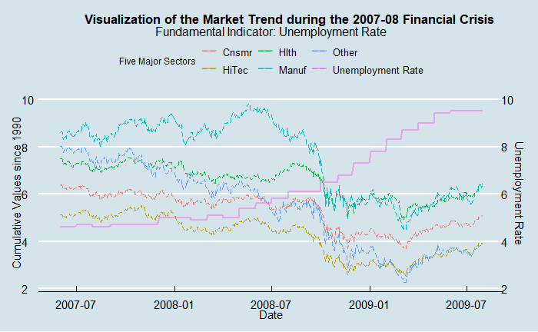
Visualizing the Market Trend During the 2007-08 Financial Crisis:
Fundamentals: Unemployment
Key Findings:
Unemployment rates already steadily decreasing starting in late 2007 and early 2008, several months, and continued to increase during the crisis
Employment rates continued to increase after the market hit the bottom in March 2009 and took a long time to recover

Slide 12
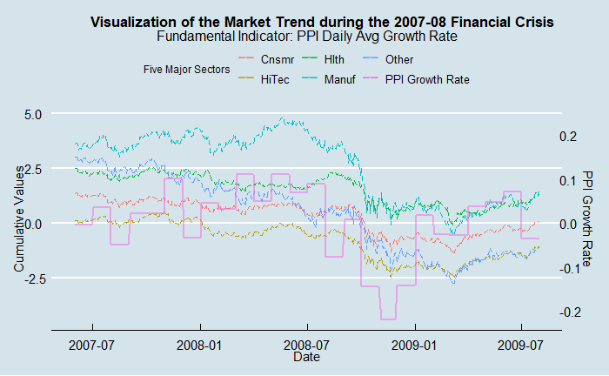
Visualizing the Market Trend During the 2007-08 Financial Crisis:
Fundamentals: PPI Growth Rate
Key Findings:
PPI growth rates were not significantly affected in the early time of the crisis
PPI growth rates only started declining until the financial crisis had almost ended
PPI growth rates were able to rebound back before the market found its bottom several months after

Slide 13
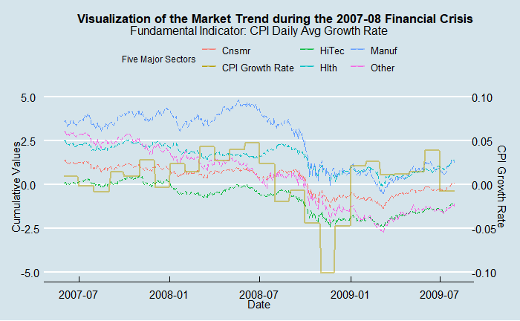
Visualizing the Market Trend During the 2007-08 Financial Crisis
Key Findings:
CPI growth rates experienced certain lags to decrease after the market
CPI growth rates decreased quickly during the middle of the crisis
CPI growth rates found the bottom 2 months before the market reached its bottom

Slide 14
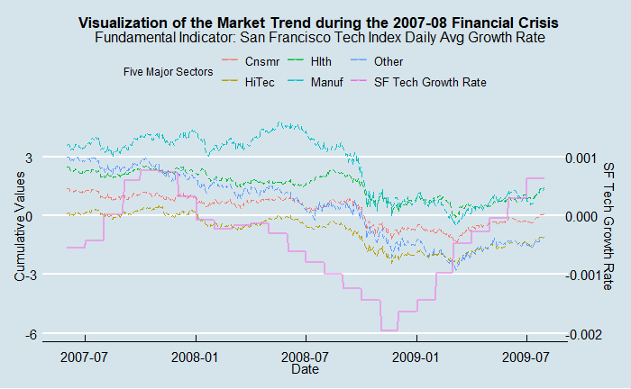
Visualizing the Market Trend During the 2007-08 Financial Crisis
Key Findings:
San Francisco Tech Index growth rate was pretty responsive to the financial crisis and the market trend
It reached its bottom several months before the market reached the bottom
It was able to jump back very rapidly

Slide 15
Summary of Findings from Visualizing the 2007-08 Financial Crisis
Summary:
Unemployment rates slightly increased before the financial crisis and market crash and took significant time to recover
CPI growth rate was only affected during the very acute time of the crisis and was able to jump back before the market reached the bottom
PPI growth rate was similar to CPI growth rate in that it was less affected in the beginning and was able to jump back very quickly
The capital-intensive SF Tech Index growth rates experienced sharp declines in the beginning of the crisis and continued to plunge with the market
SF Tech Index growth rates reached the bottom 4 months before the market

Slide 16
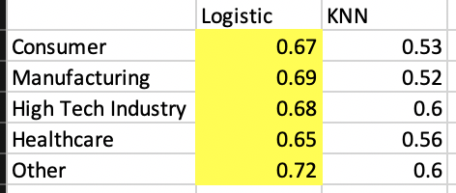
Prediction Results

Slide 17
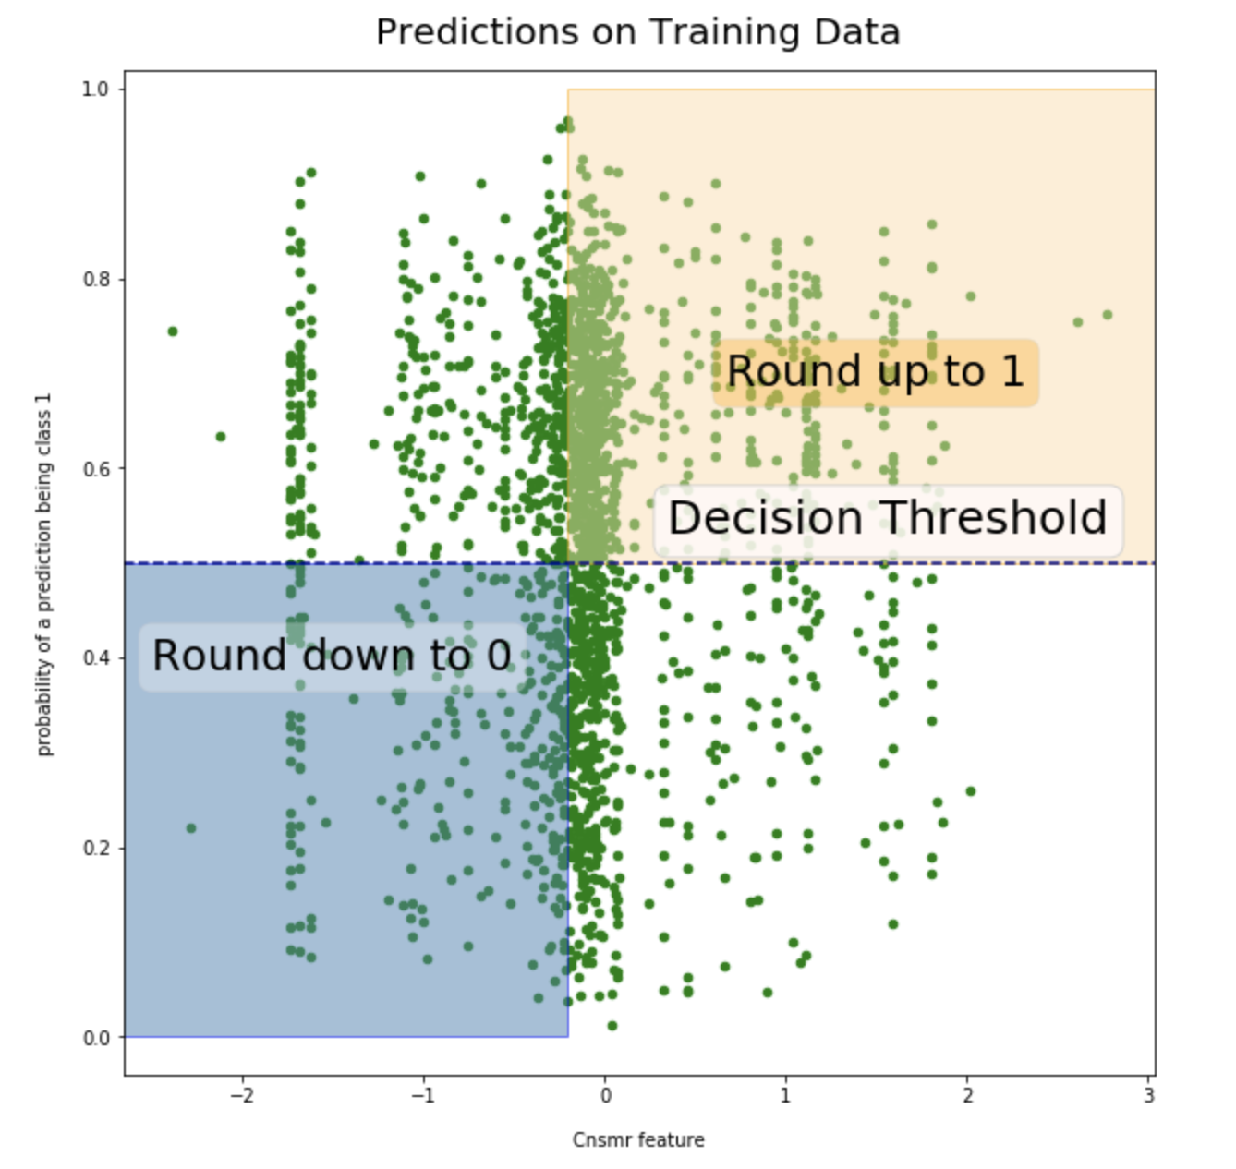
Prediction Results

